Slide 1

Chapter 8
Testing the Programs
This lecture is based on the Chapter 8 of the book “Software Engineering: Theory and Practice”.

Slide 2
Contents
8.1 Software Faults and Failures
8.2 Testing Issues
8.3 Unit Testing
8.4 Integration Testing
8.5 Test Planning
8.6 Automated Testing Tools
8.7 When to Stop Testing

Slide 3
Chapter 8 Objectives
Types of faults and how to clasify them
The purpose of testing
Unit testing
Integration testing strategies
Test planning
When to stop testing

Slide 4
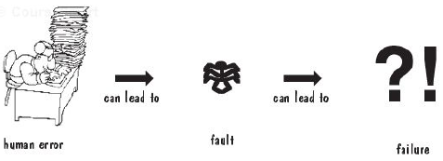
8.1 Software Faults and Failures
What are faults and failures?
Fault:
  called error, occurs when a human makes a mistake in performing some software activities.
  inside view of a system, seen by developers
Failure:
  a departure from the system is required.
  outside view of a system, seen by users.
Human errors cause a failure

Slide 5
8.1 Software Faults and Failures
Why Does Software Fail?
Wrong requirement: not what the customer wants
Missing requirement
Requirement impossible to implement
Faulty design
Faulty code
Improperly implemented design

Slide 6
8.1 Software Faults and Failures Objective of Testing
Objective of testing: discover faults
A test is successful only when a fault is discovered
  Fault identification is the process of determining what fault caused the failure
  Fault correction is the process of making changes to the system so that the faults are removed

Slide 7
8.1 Software Faults and Failures
Types of Faults
Algorithmic fault
Computation and precision fault
  a formula’s implementation is wrong
Documentation fault
  Documentation doesn’t match what program does
Capacity or boundary faults
  System’s performance not acceptable when certain limits are reached
Timing or coordination faults
Performance faults
  System does not perform at the speed prescribed
Standard and procedure faults

Slide 8
8.1 Software Faults and Failures
Typical Algorithmic Faults
An algorithmic fault occurs when a component’s algorithm or logic does not produce proper output
  Branching too soon
  Branching too late
  Testing for the wrong condition
  Forgetting to initialize variable or set loop invariants
  Forgetting to test for a particular condition
  Comparing variables of inappropriate data types
Syntax faults

Slide 9
8.2 Testing Issues
Testing Organization
Module testing, component testing, or unit testing
Integration testing
Function testing
Performance testing
Acceptance testing
Installation testing

Slide 10
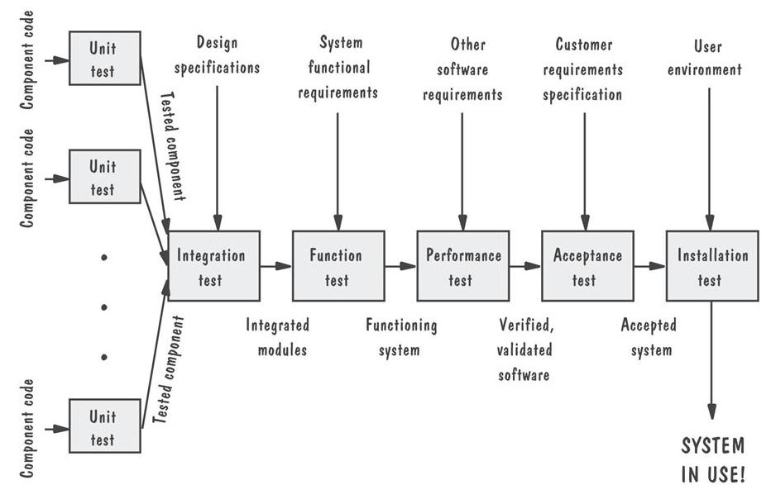
8.2 Testing Issues
Testing Organization Illustrated

Slide 11
8.2 Testing Issues
Who Performs the Test?
Independent test team
  avoid conflict
  improve objectivity
  allow testing and coding concurrently

Slide 12
8.2 Testing Issues
Views of the Test Objects
Closed box or black box: functionality of the test objects
Clear box or white box: structure of the test objects

Slide 13
8.2 Testing Issues
Black Box
Advantage
  free of internal structure’s constraints
Disadvantage
  not possible to run a complete test
  eg. ax²+bx+c=0

Slide 14
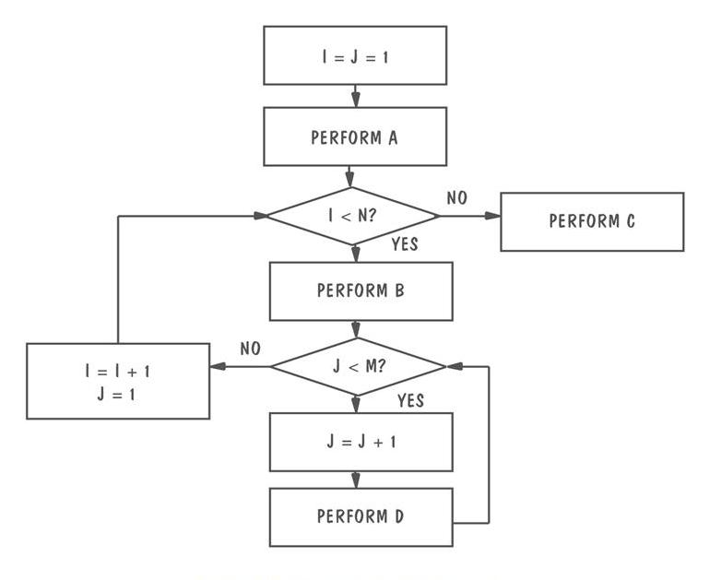
8.2 Testing Issues
Clear Box
Example of logic structure

Slide 15
8.2 Testing Issues
Factors Affecting the Choice of Test Philosophy
The number of possible logical paths
The nature of the input data
The amount of computation involved
The complexity of algorithms

Slide 16
8.3 Unit Testing
Code Review
Code walkthrough
Code inspection

Slide 17
8.3 Unit Testing
Proving Code Correct
Formal proof techniques
Symbolic execution
Automated theorem-proving

Slide 18
8.3 Unit Testing
Testing versus Proving
Proving: hypothetical environment
Testing: actual operating environment

Slide 19
8.3 Unit Testing
Steps in Choosing Test Cases
Determining test objectives
Selecting test cases

Slide 20
8.3 Unit Testing
Test Thoroughness
Statement testing
Branch testing
Path testing
Definition-use testing
All-uses testing
All-predicate-uses/some-computational-uses testing
All-computational-uses/some-predicate-uses testing

Slide 21
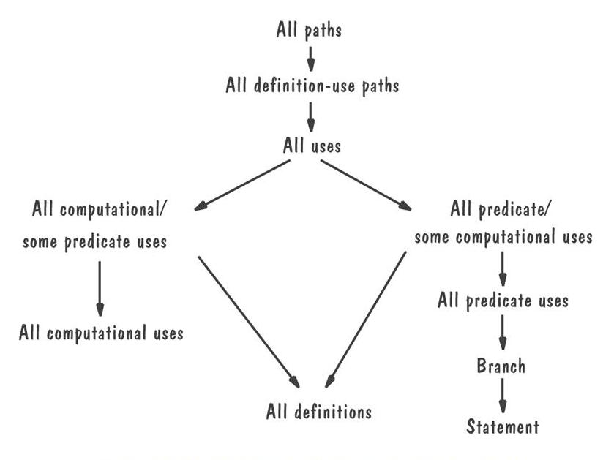
8.3 Unit Testing
Relative Strengths of Test Strategies

Slide 22
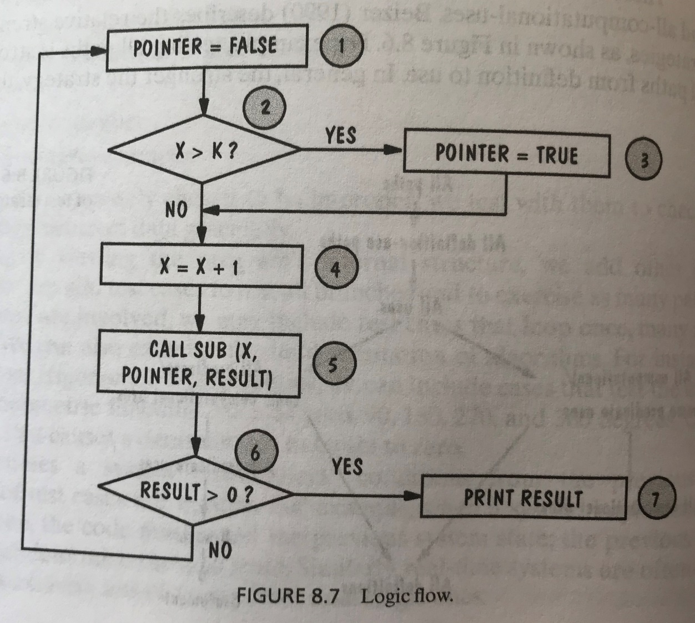
8.3 Unit Testing
Example of Different Test Strategies
Statement testing
1-2-3-4-5-6-7
Branch testing
1-2-3-4-5-6-7
1-2-4-5-6-1
Path testing
1-2-3-4-5-6-7
1-2-3-4-5-6-1
1-2-4-5-6-7
1-2-4-5-6-1

Slide 23
8.4 Integration Testing
Bottom-up
Top-down
Big-bang
Sandwich testing
Modified top-down
Modified sandwich

Slide 24
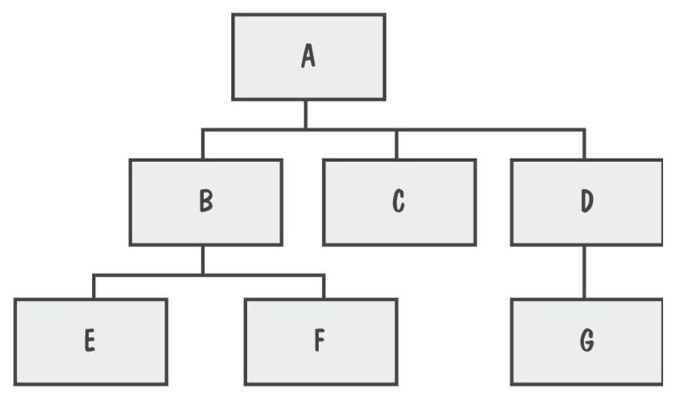
8.4 Integration Testing
View of a System
System viewed as a hierarchy of components

Slide 25
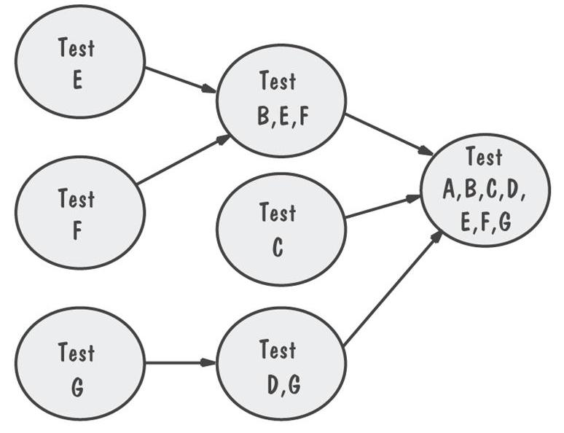
8.4 Integration Testing
Bottom-Up Integration Example
The sequence of tests and their dependencies

Slide 26
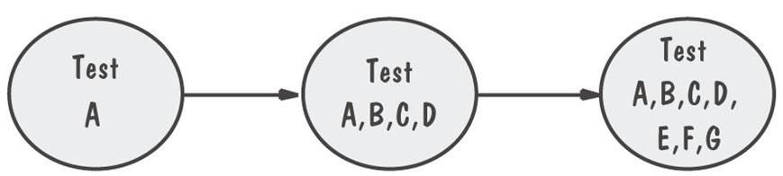
8.4 Integration Testing
Top-Down Integration Example
Only A is tested by itself

Slide 27
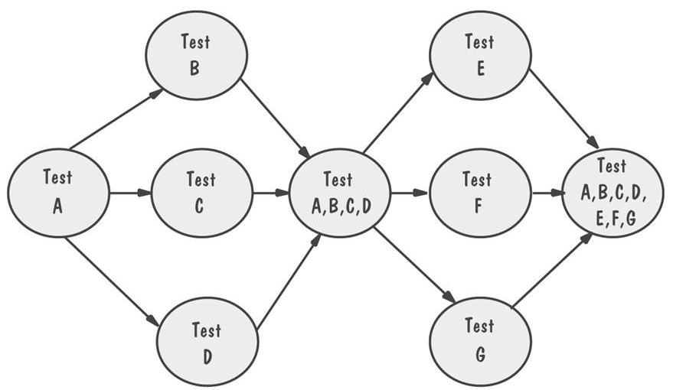
8.4 Integration Testing
Modified Top-Down Integration Example
Each level’s components individually tested before the merger takes place

Slide 28
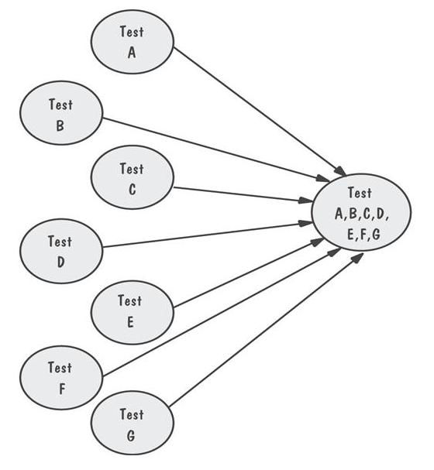
8.4 Integration Testing
Big-Bang Integration Example
Requires both stubs and drivers to test the independent components

Slide 29
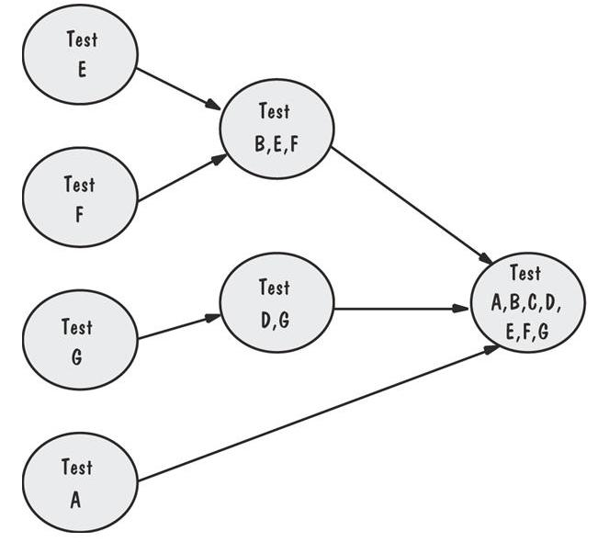
8.4 Integration Testing
Sandwich Integration Example
Viewed system as three layers

Slide 30
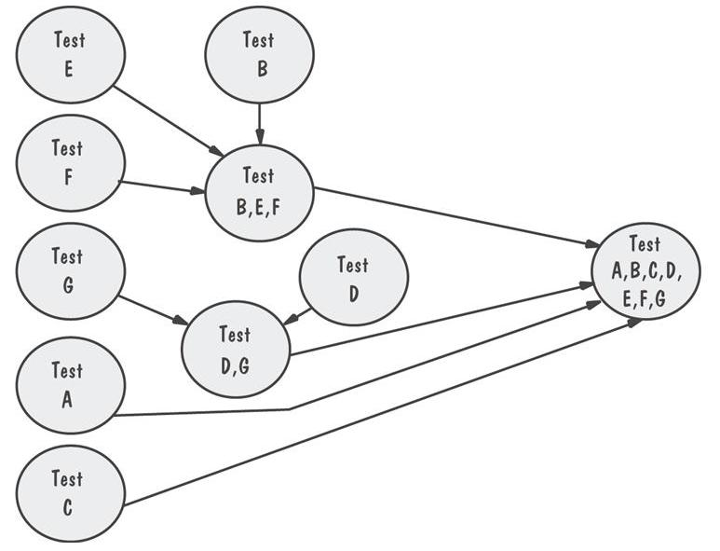
8.4 Integration Testing
Modified Sandwich Integration Example
Allows upper-level components to be tested before merging them with others

Slide 31
8.4 Integration Testing
Comparison of Integration Strategies
 | Bottom-up | Top-down | Modified top-down | Bing-bang | Sandwich | Modified sandwich
Integration | Early | Early | Early | Late | Early | Early
Time to basic working program | Late | Early | Early | Late | Early | Early
Component drivers needed | Yes | No | Yes | Yes | Yes | Yes
Stubs needed | No | Yes | Yes | Yes | Yes | Yes
Work parallelism at beginning | Medium | Low | Medium | High | Medium | High
Ability to test particular paths | Easy | Hard | Easy | Easy | Medium | Easy
Ability to plan and control sequence | Easy | Hard | Hard | Easy | Hard | hard

Slide 32
8.5 Test Planning
Establish test objectives
Design test cases
Write test cases
Test test cases
Execute tests
Evaluate test results

Slide 33
8.5 Test Planning
Purpose of the Plan
Test plan explains
  who does the testing
  why the tests are performed
  how tests are conducted
  when the tests are scheduled

Slide 34
8.5 Test Planning
Contents of the Plan
What the test objectives are
How the test will be run
What criteria will be used to determine when the testing is complete

Slide 35
8.6 Automated Testing Tools
Code analysis
  Static analysis
    code analyzer
    structure checker
    data analyzer
    sequence checker
Dynamic analysis
  program monitors: watch and report program’s behavior

Slide 36
8.6 Automated Testing Tools (continued)
Test execution
  Capture and replay
  Stubs and drivers
  Automated testing environments
Test case generators

Slide 37
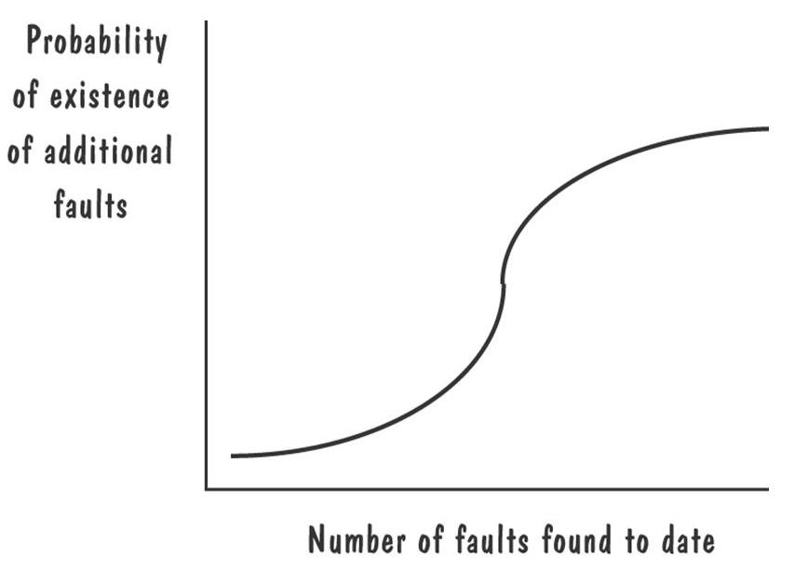
8.7 When to Stop Testing
More faulty?
Probability of finding faults during the development

Slide 38
8.7 When to Stop Testing
Stopping Approaches
Coverage criteria
Fault seeding
    detected seeded Faults ₌ detected nonseeded faults
    total seeded faults total nonseeded faults
Confidence in the software, C
    = 1, if n >N
    = S/(S – N + 1) if n ≤ N

Slide 39
Summary
Software faults and failures
  It is important to understand the difference between faults and failures
Process of testing
  The goal of testing is to find faults, not to prove correctness
Unit testing
Integration testing

Slide 40
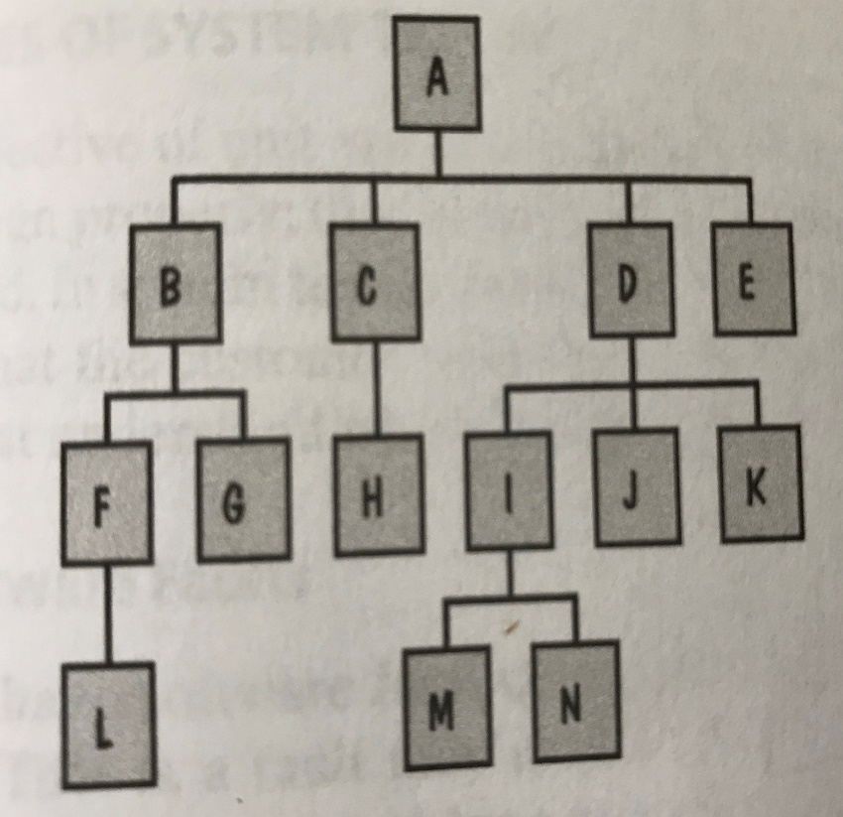
Assignment
This figure illustrates the component hierarchy in a software system. Describe the sequence of tests for integrating the components using a bottom-up approach, a top-down approach, a modified top-down approach, a big-bang approach, a sandwich approach and a modified sandwich approach.

